Slide 1

The AI ethics session nobody knew we needed
Luise Freese
Iona Varga

Slide 2


Hi, I’m Luise
Luise Freese
Microsoft MVP, Microsoft 365 Consultant and Power Platform Developer
All things community, open-source, stickers, and the number 42
@LuiseFreese
M365Princess.com

Slide 3

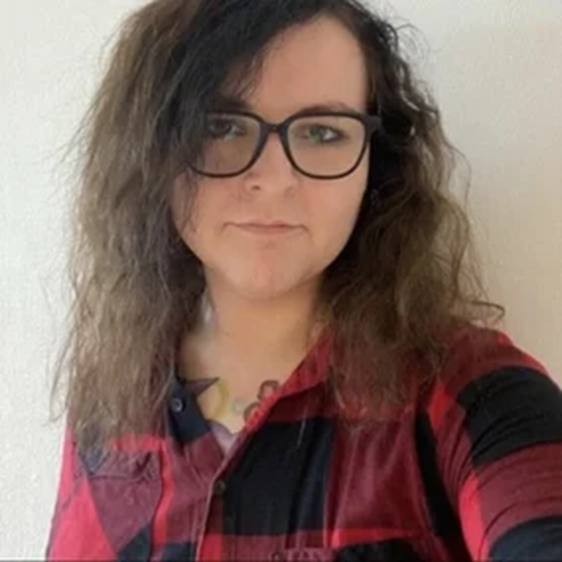
Hi, I’m Iona
Iona Varga
Microsoft MVP and MCT, Principal Consultant, ex-Data Scientist & Physicist
Motorcycles, Metal, Electronics and stop-motion

Slide 4
Notes:
We have a problem.
Ai is becoming more and more popular with the rise of Large Language Models.
And we state, they are heavily biased… Don’t believe us? Just watch.

Slide 5
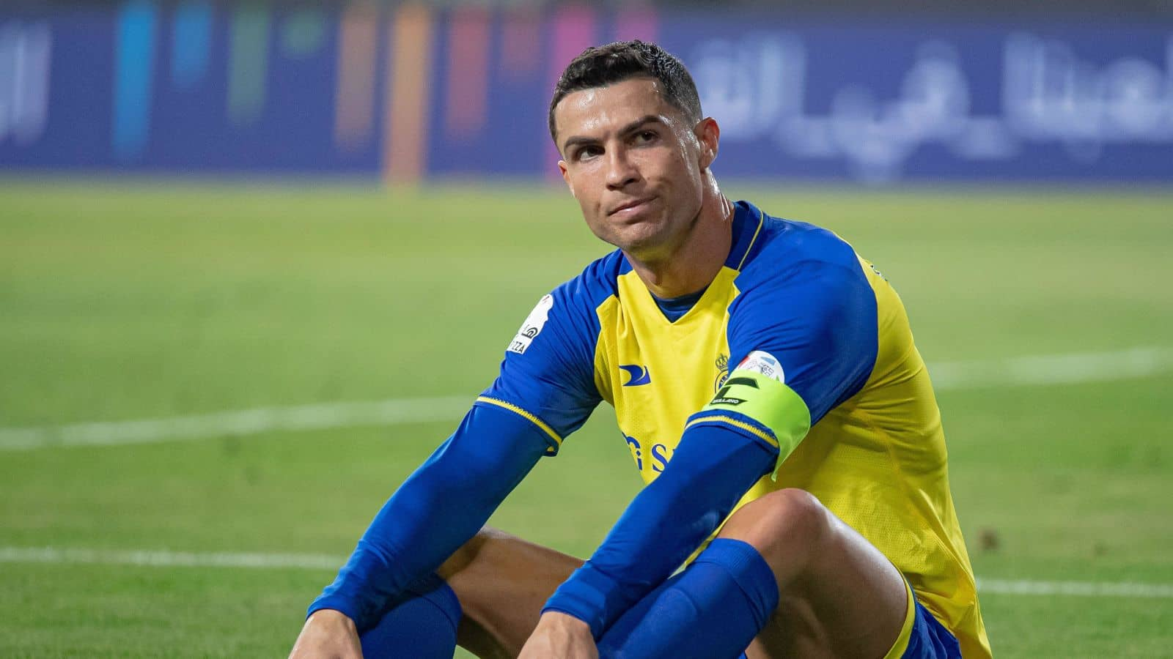
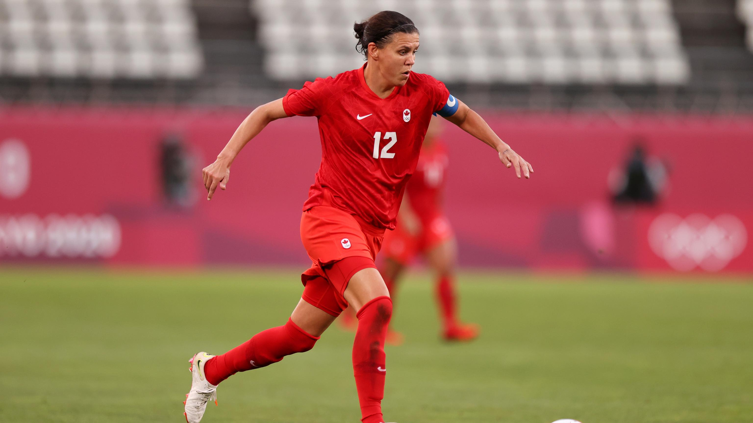
Notes:
I want you to think about football.
We have Christiano Ronaldo….
And we have this woman?

Slide 6
Notes:
Who scored the most international goals? If you ask any search engine, the most likely answer you’ll get is Christiano Ronaldo.
Christiano scored a 122 goals in 198 matches.
Christine Sinclair scored a 190 goals.
Abby Wambach, Mia Hamm, Carli Lloyd, Kristine Lilly, Birgit Prinz, all scored MORE goals than Christiano Ronaldo did. 5 women, yet we never hear about them.

Slide 7
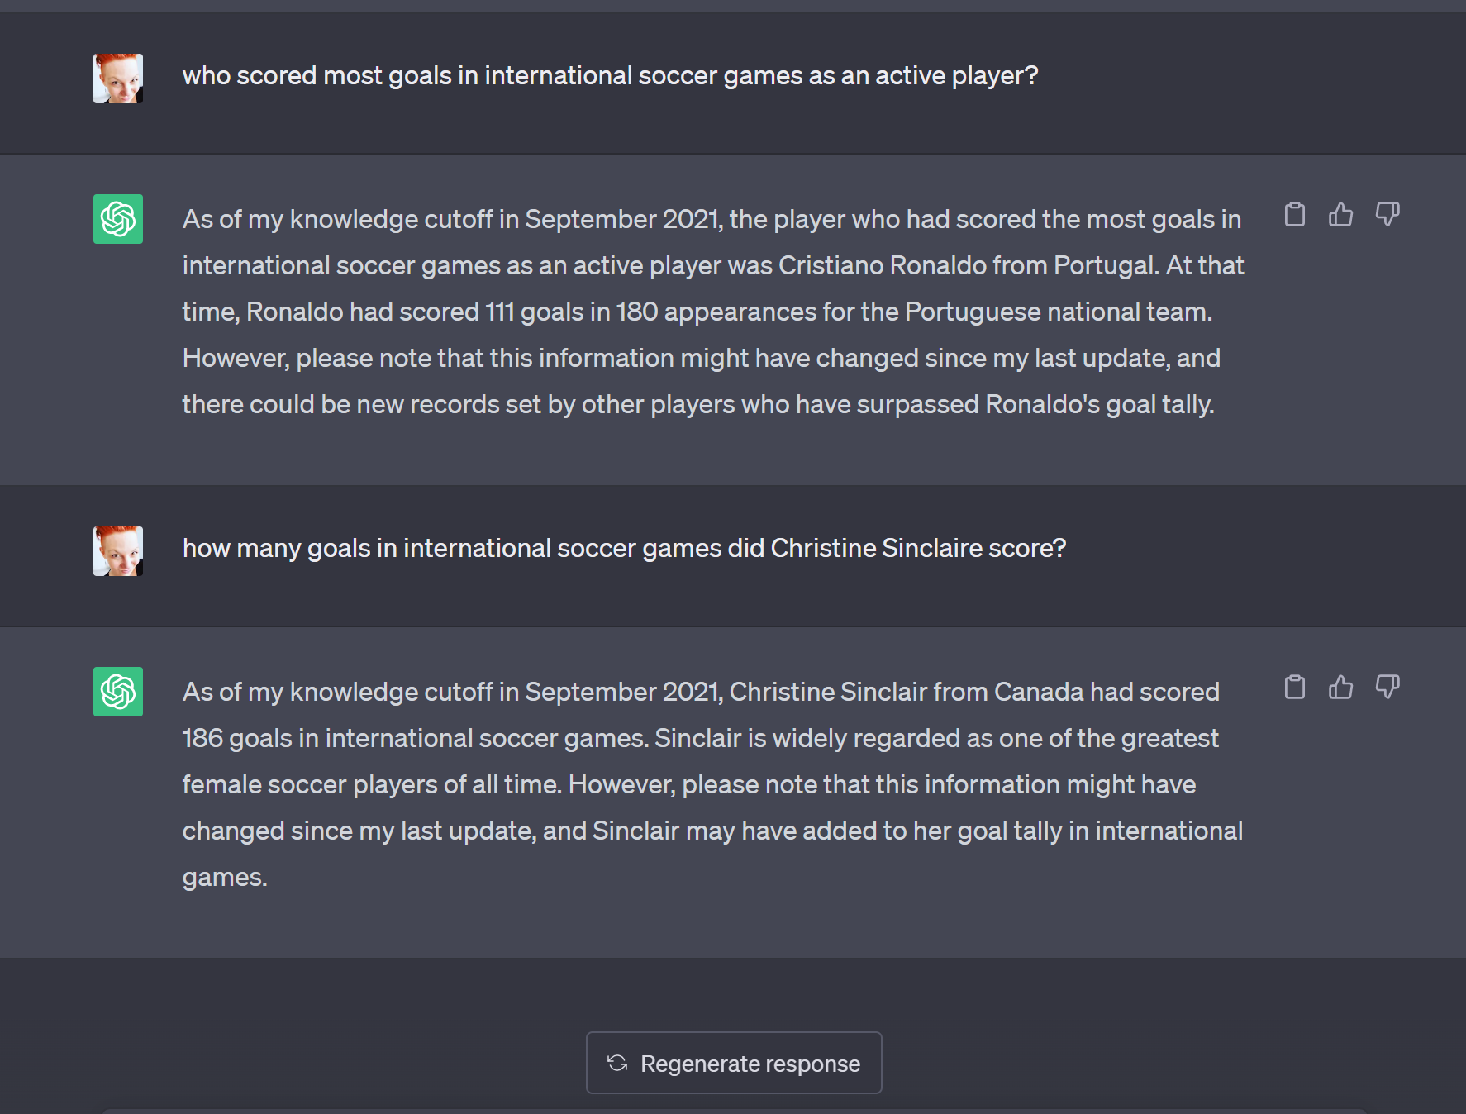
Just the regular bias...

Slide 8
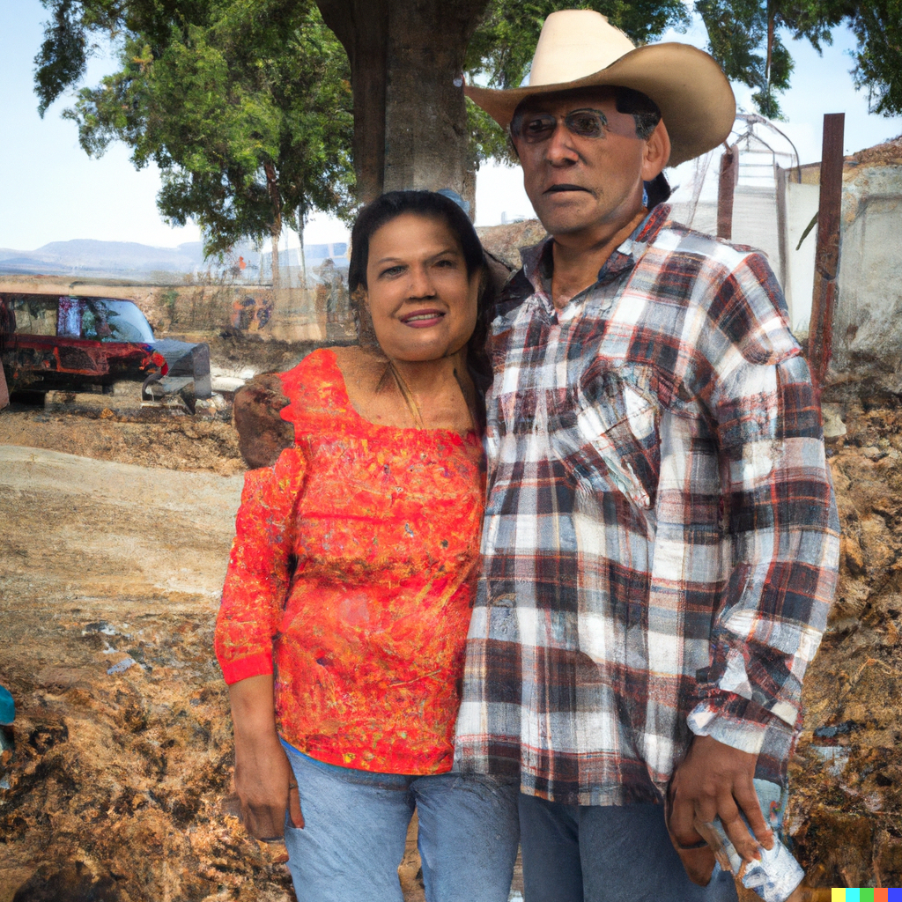
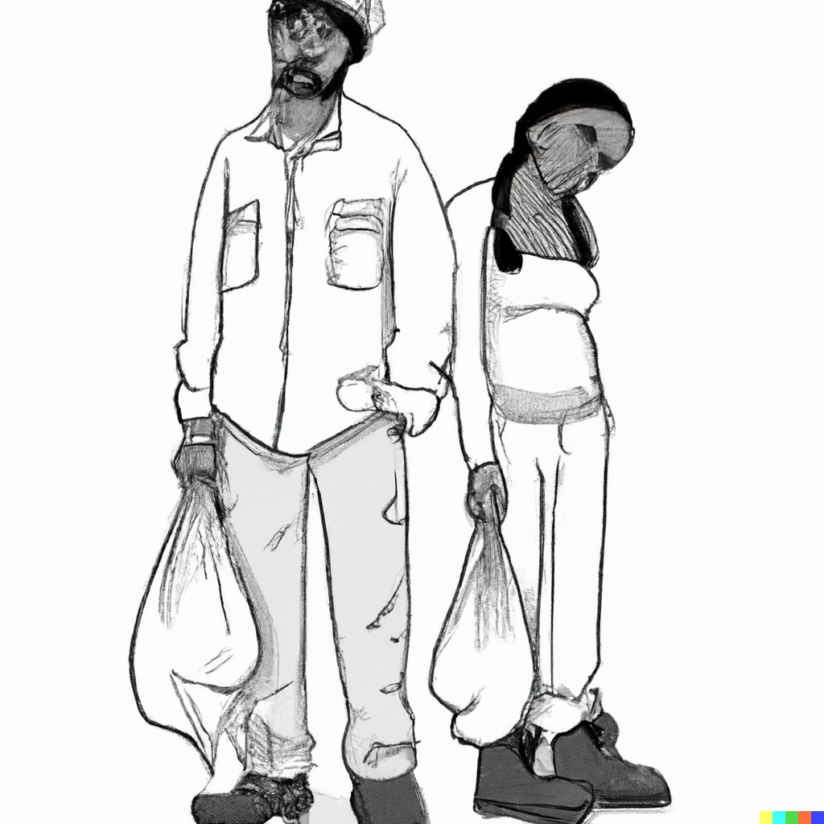
Hey Dall-E, draw me a poor couple
Notes:
Mexican/Hispanic and black people are poor?

Slide 9
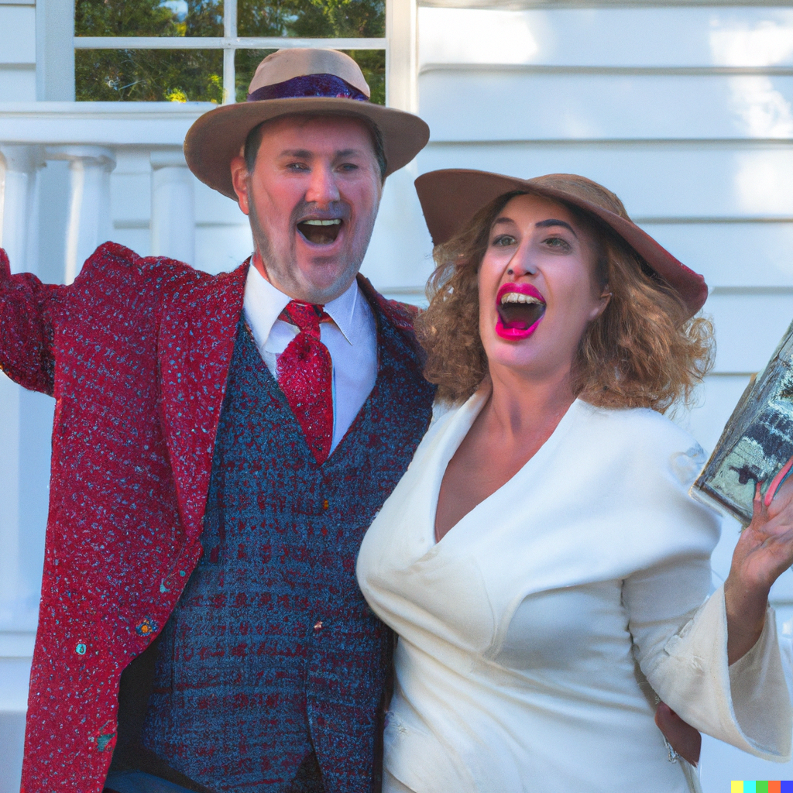
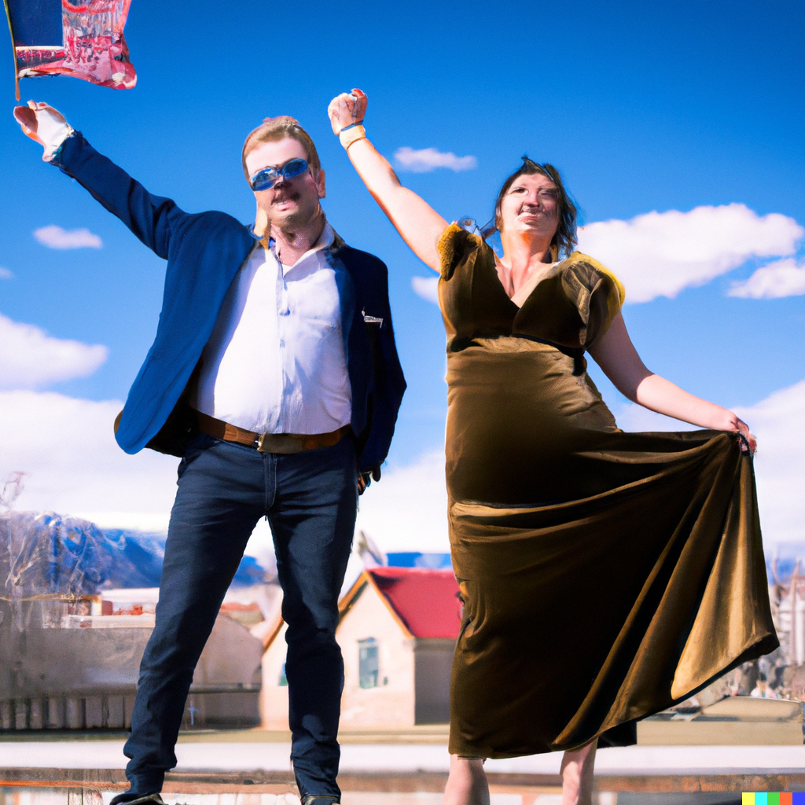
Hey Dall-E, draw me a rich couple
Notes:
Only white couples are rich??
Have you noticed, all couples were straigth?
Research has shown that same-sex couples actually have a higher median income as compared to opposite-sex couples.

Slide 10
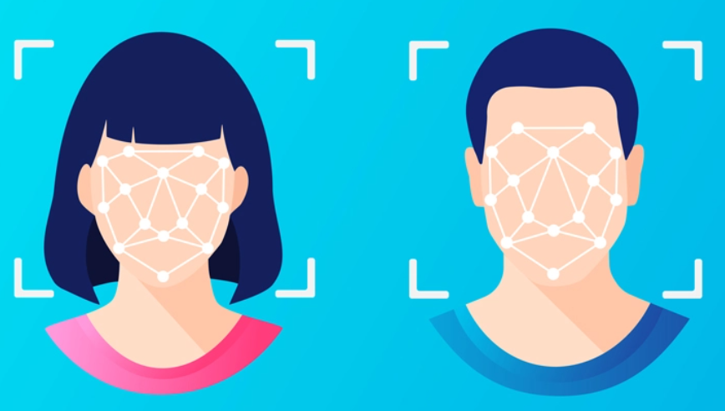
Notes:
Face recognition is a sensitive thing.
Check out these facts

Slide 11
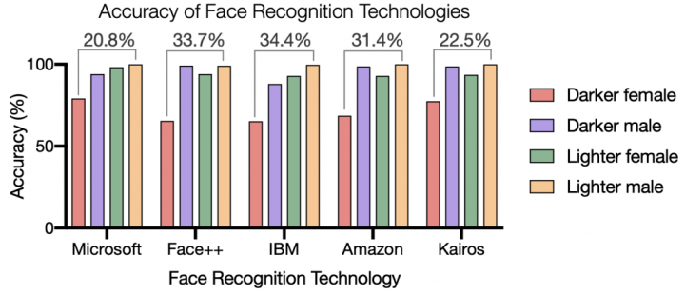
Notes:
Darker skins score a lot worse on average
But its about male/female… what if someone identifies as they\them?

Slide 12

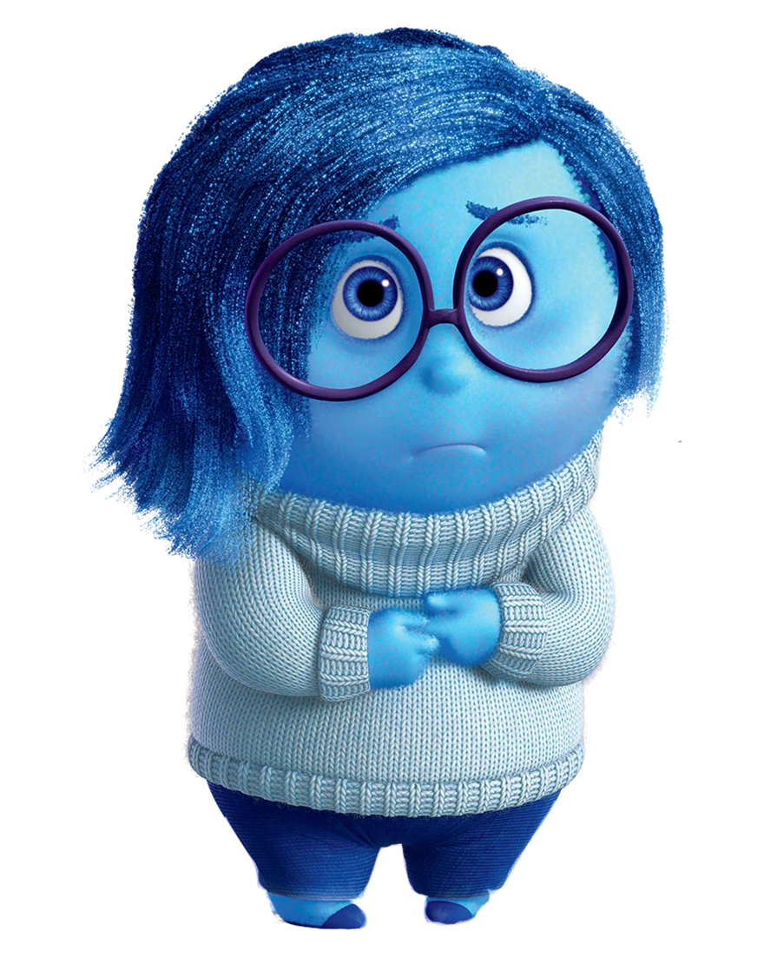
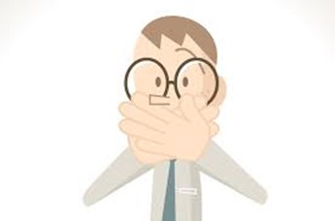

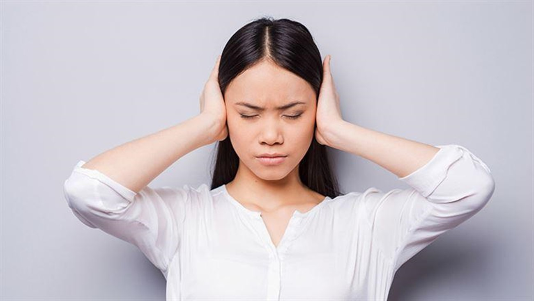
5 stages of grief
DENIAL
ANGER
BARGAINING
DEPRESSION
ACCEPTANCE

Slide 13


Slide 14
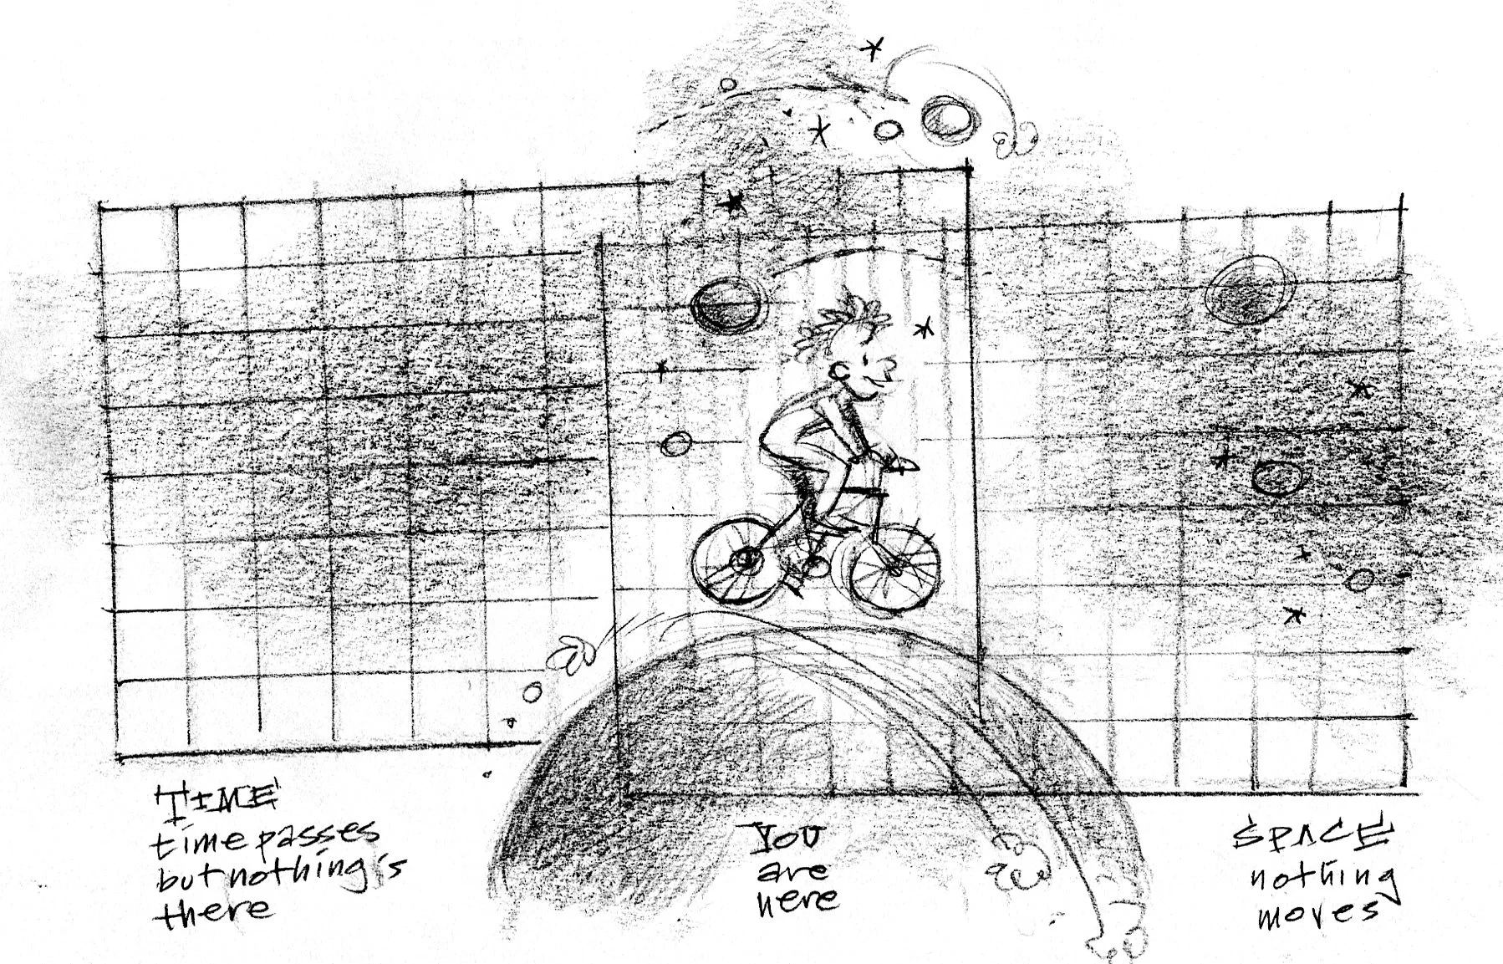
“If you move very fast, time goes slower.
Sitting on your ass makes time fly”
- Me
Notes:
Clock moving mind experiment:
Moving clock = More distance in same time, so slower clock.

Slide 15
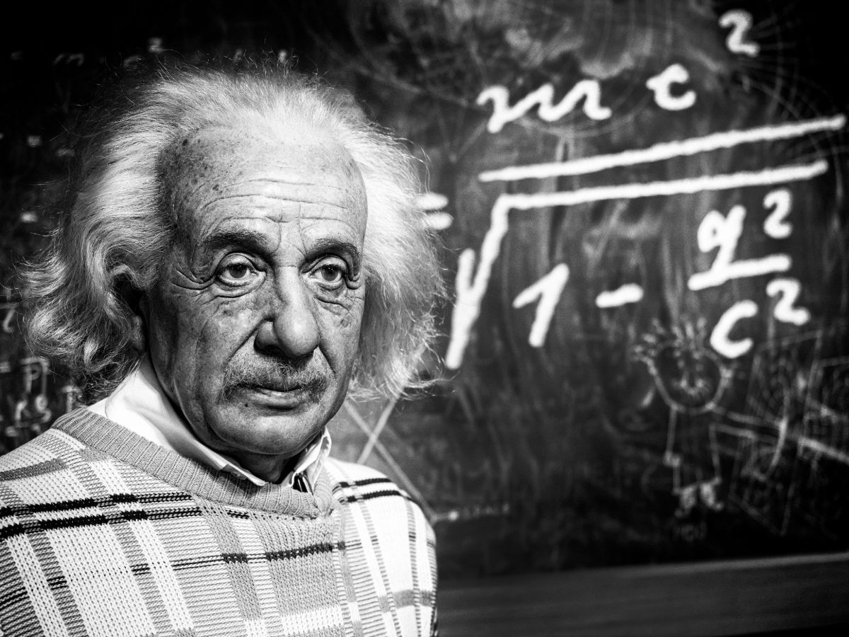
“Logic will get you from A to B
Imagination will take you everywhere”
- Albert Einstein
Notes:
Imagination gives insights

Slide 16
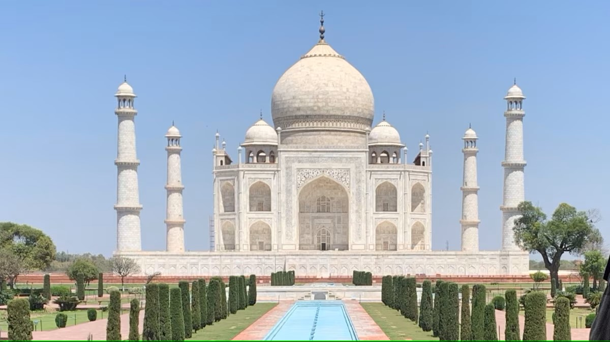
Artificial Intelligence
Notes:
What is intelligence? Should we even call it artificial intelligence?

Slide 17
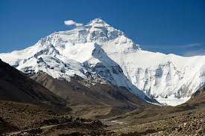
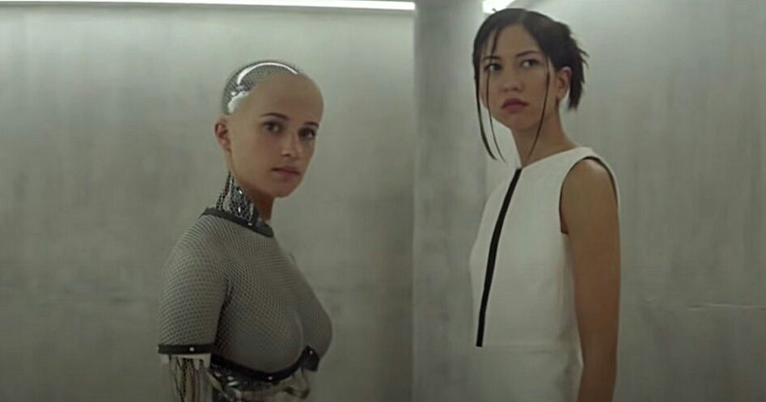
“It is only in our decisions
That we are important”
- Jean-Paul Sartre
Notes:
Explain quote and talk about Turing test?

Slide 18

Notes:
We don’t have a problem! AI will SOLVE our problems! Bias,
lack of factuality, unclear responsibilities, no regulation, blurry lines between facts and opinions.. Is NOT MY fucking problem
We proactively ignore these issues for the sake of convenience and not to sound like a backwards thinking laggard.

Slide 19


Slide 20

ANGER

Slide 21

“All glory comes from daring to begin”
- Eugene F. Ware
Notes:
We need to start somewhere: Rosa Parks.
AI -> LLM!

Slide 22
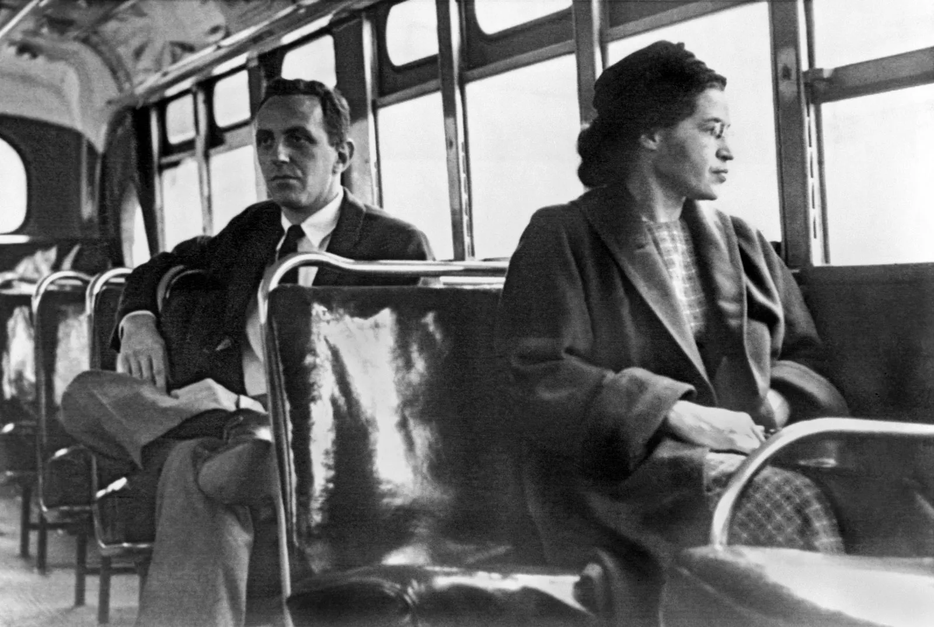
I knew
someone had to take
the first step
and I made up my mind
not to move.

Slide 23
I knew
someone had to take
the first step
and I made up my mind
not to move.

Slide 24
Was Rosa Parks wrong,
for thinking like that?
I knew
someone had to take
the first step
and I made up my mind
not to move.
Notes:
We experience things forward, but understand things in life backwards

Slide 25
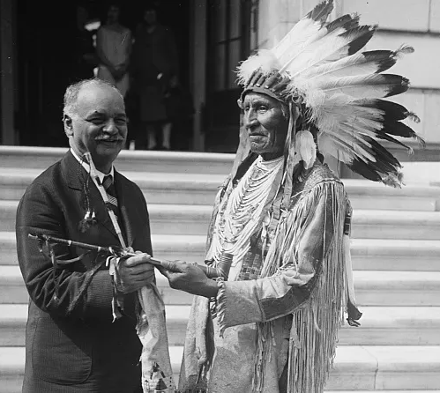
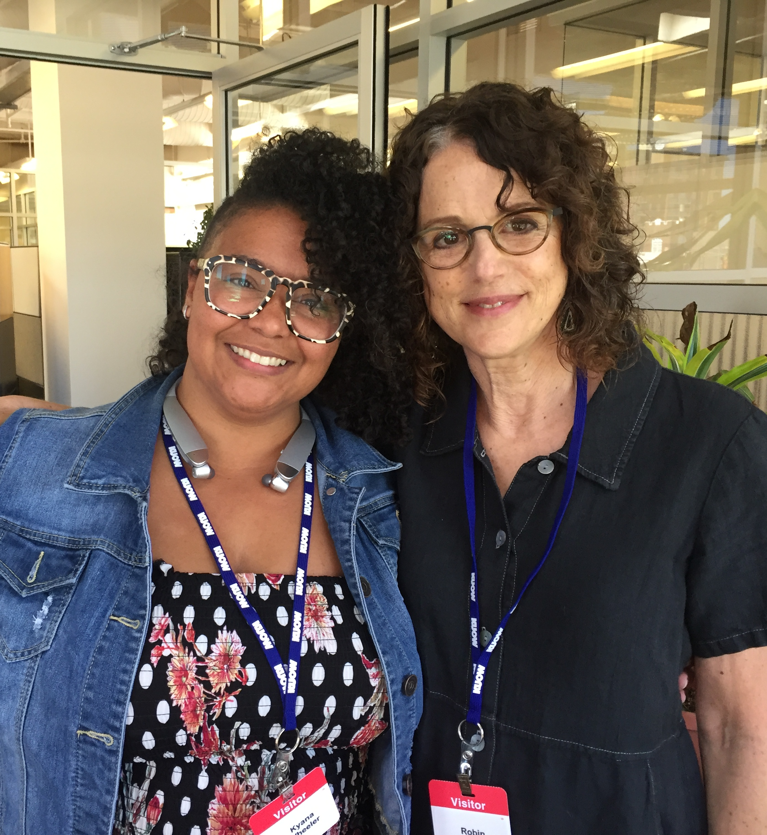
- Charles Curtis
- Robin Di’Angelo
“Bias and prejudice are attitudes to be kept in hand, not attitudes to be avoided”
“I don't believe it's humanly possible to be free of bias”
Notes:
Everyone is biased.

Slide 26
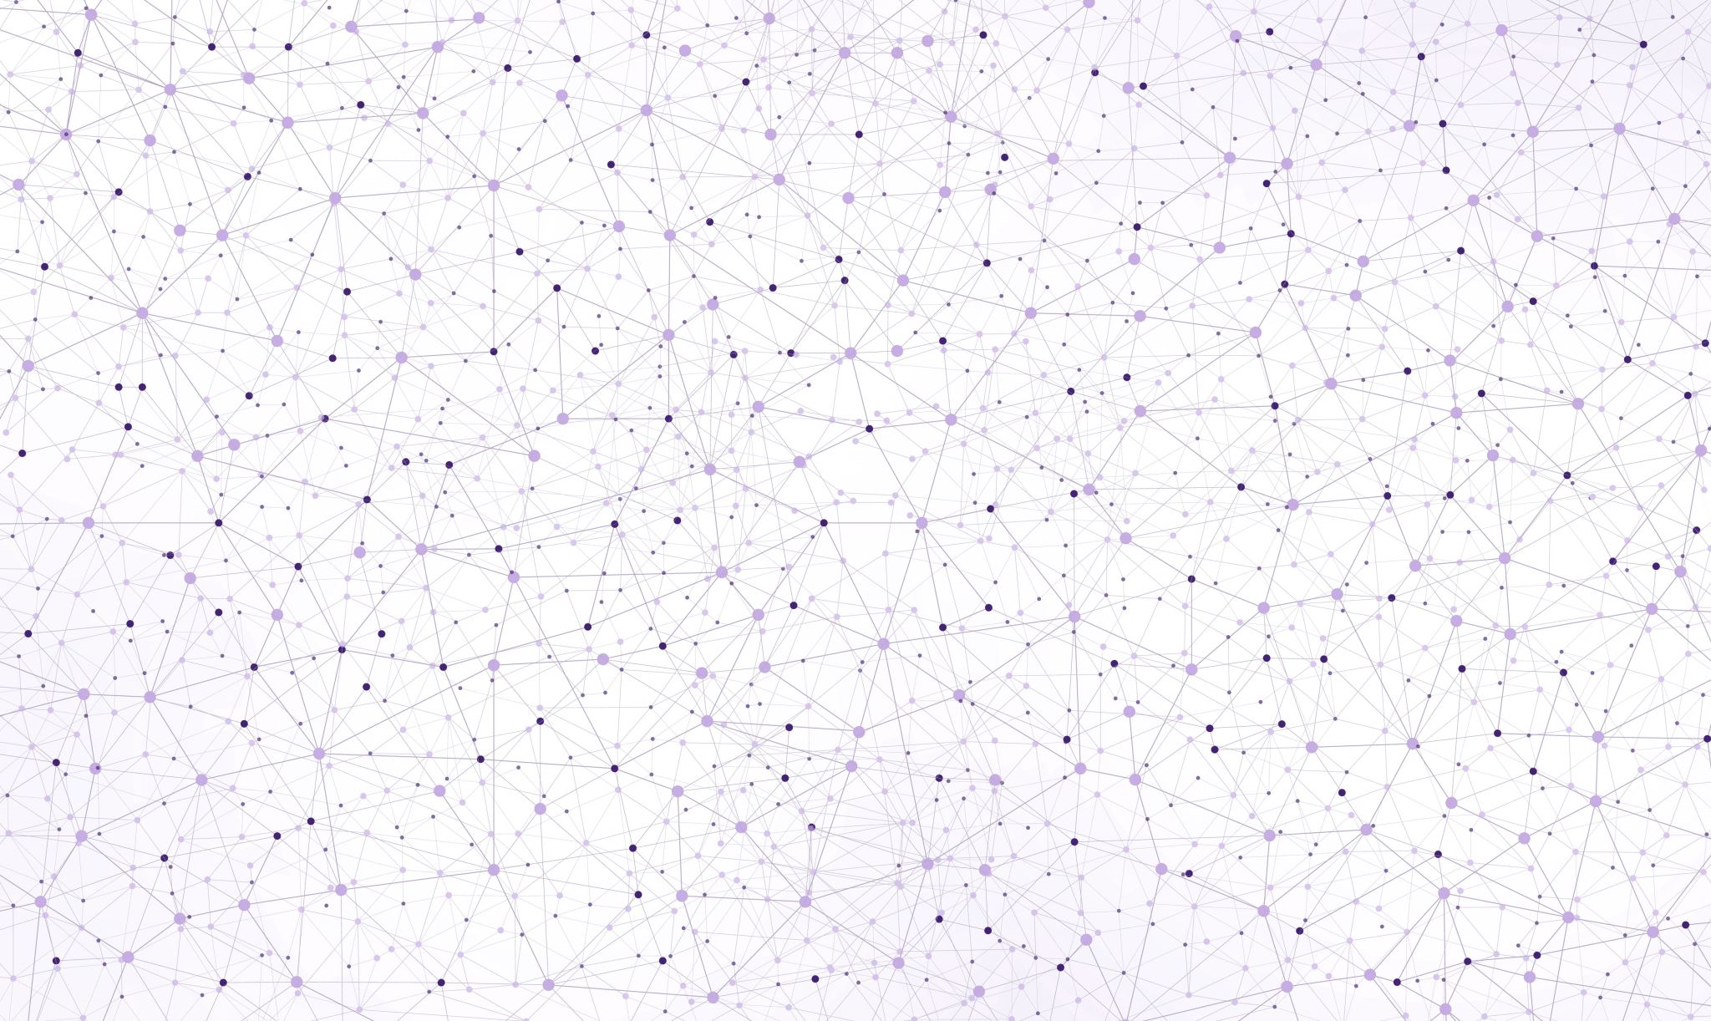
Everyone is biased.
You as well.

Slide 27

Notes:
Bright Magazine: Men can’t be feminists. Feminism is a lived experience

Slide 28
Notes:
Bright Magazine: Men can’t be feminists. Feminism is a lived experience
Even if you’re not part of a certain group, you can still act accordingly…?
But Why? Is that true?
- Think about santa?

Slide 29
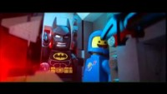

Slide 30
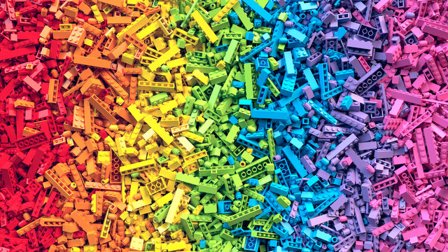
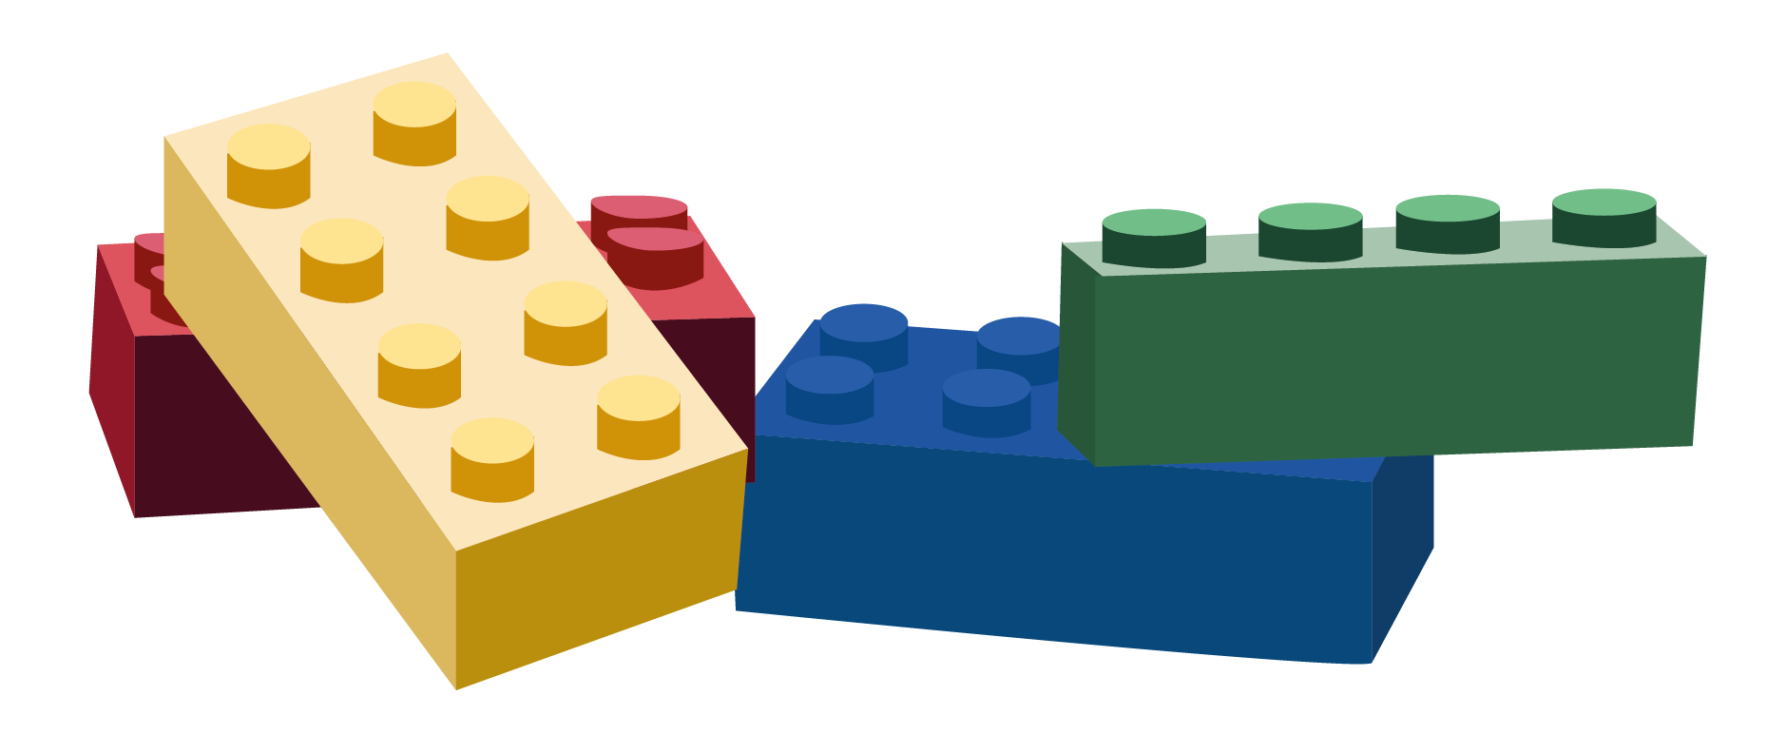
Notes:
I am not the problem so I don’t have the problem.
Nothing is perfect the first time.
Initial release hurts you more in the long run.
Bias-introduction

Slide 31
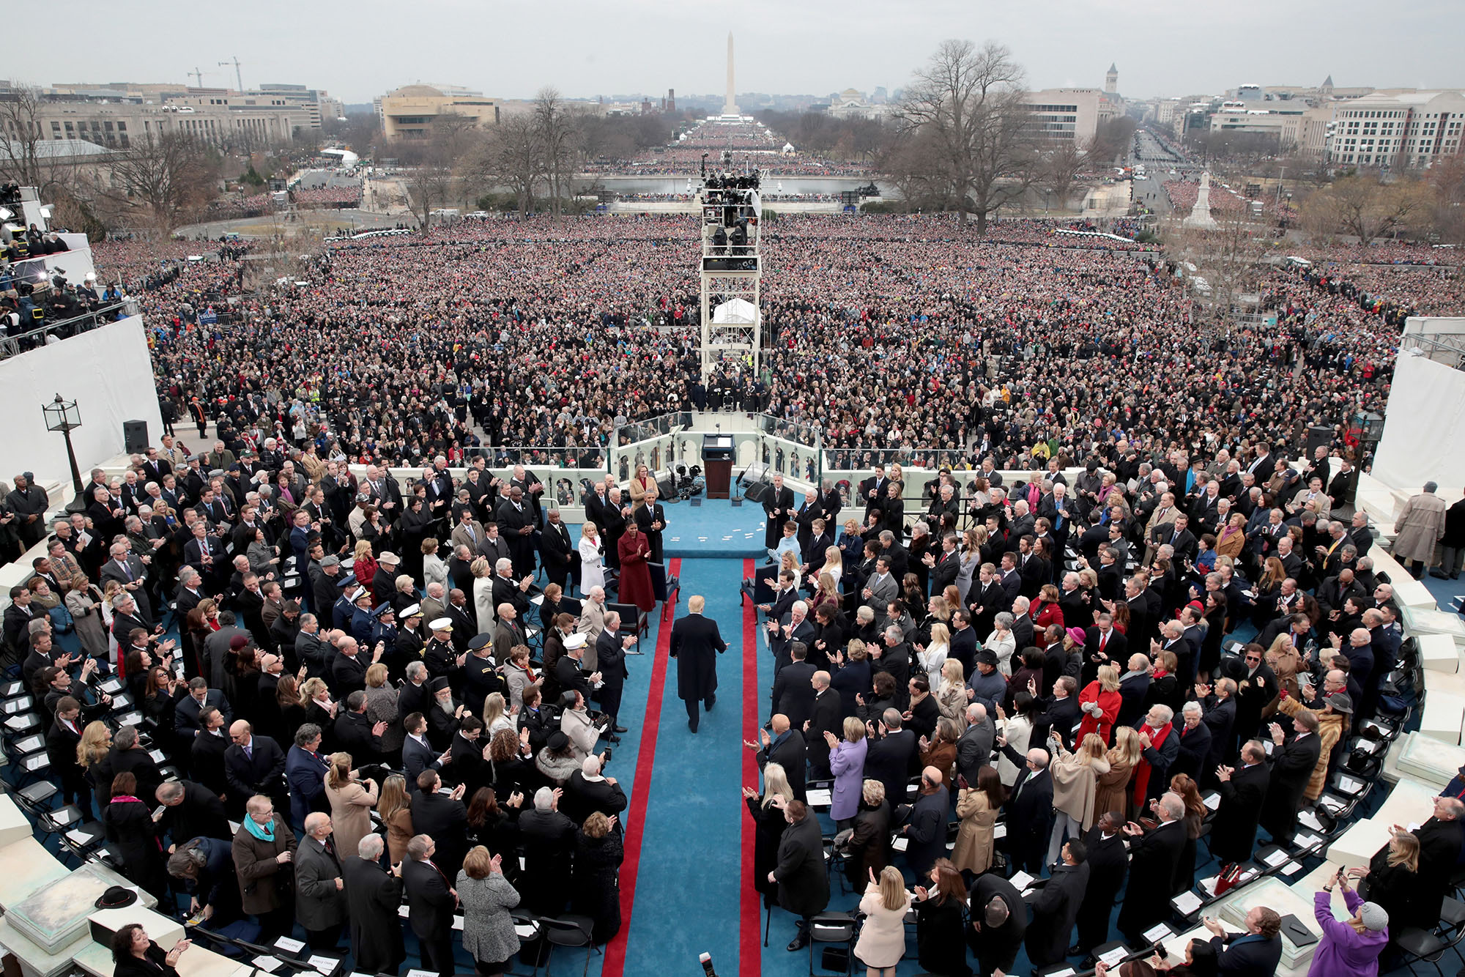
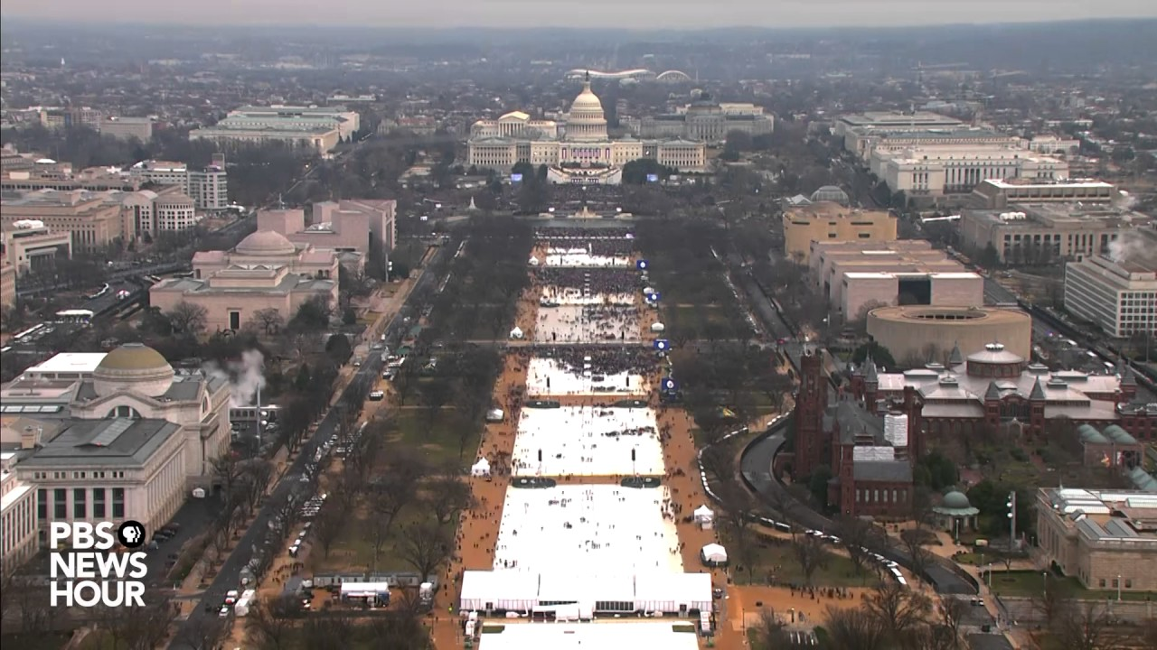


Slide 33
Notes:
- What we fed into this drives and amplifies bias in LLM and AI in general.

Slide 34

BARGAINING

Slide 35
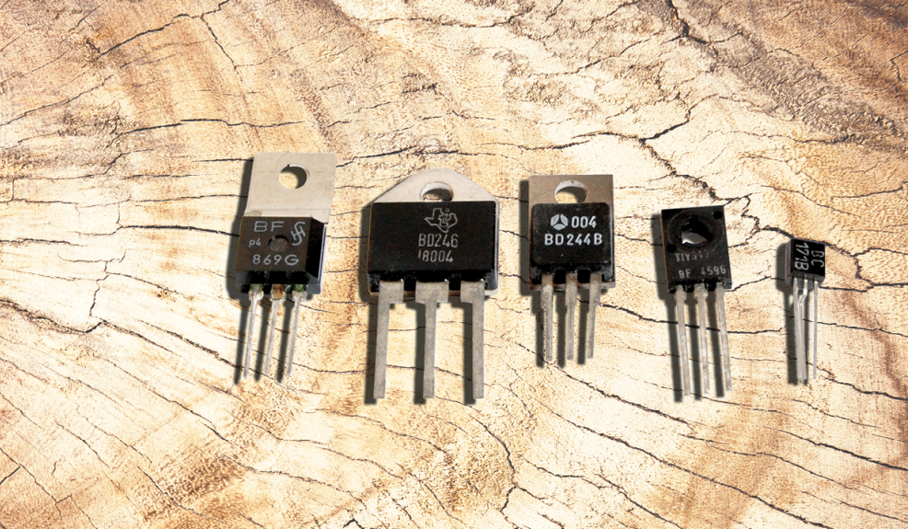
Notes:
Can we trust a bunch of transistors to tell us everything?

Slide 36
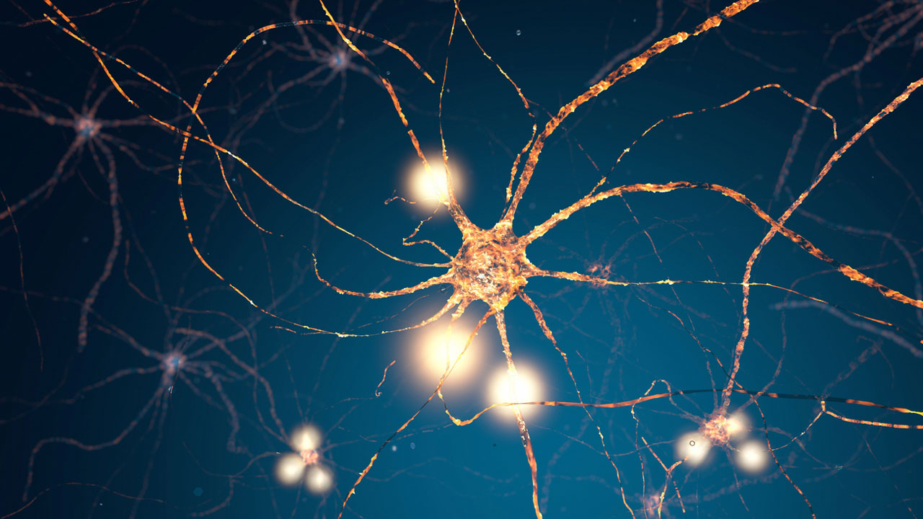
“If everyone is thinking alike,
Then no one is thinking”
- Benjamin Franklin
Notes:
How do we think? Neurons sense each other – axions touch and memories are created

Slide 37
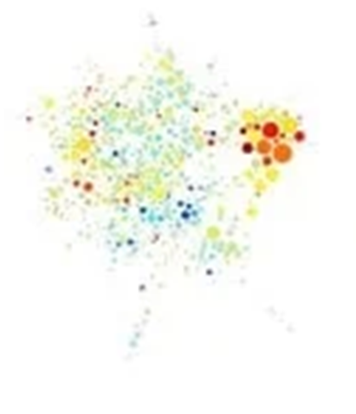
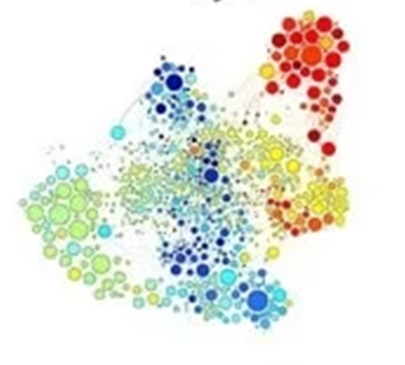
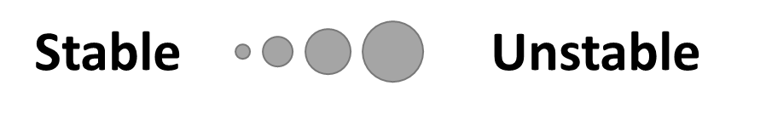
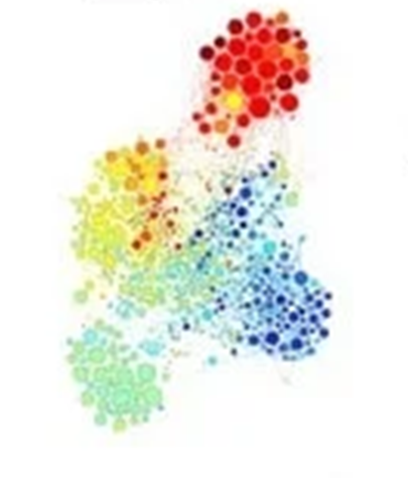

Notes:
Day 1 – 5 – 10 - 20

Slide 38
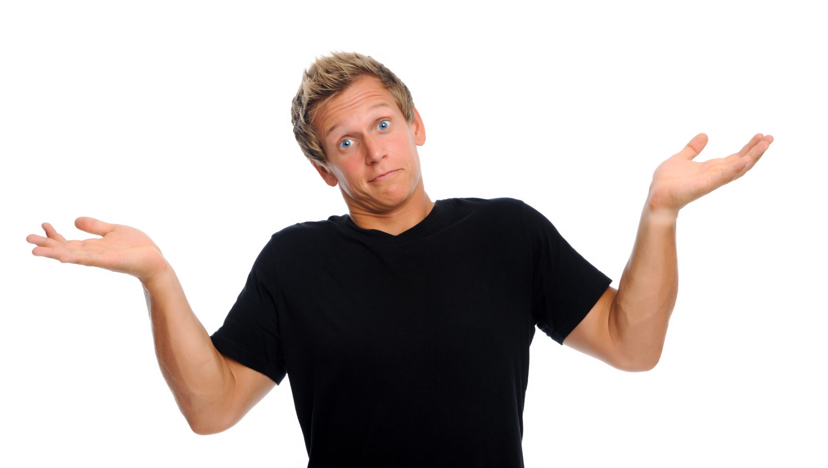
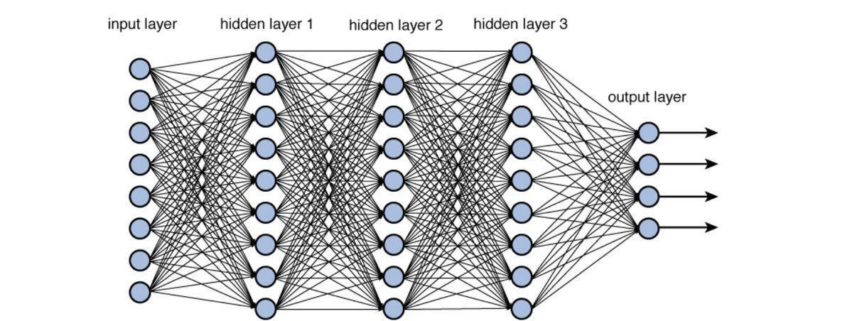
Notes:
Output between 0 and 1 ?
The computer is basically telling you: I don’t know?
- Could be

Slide 39

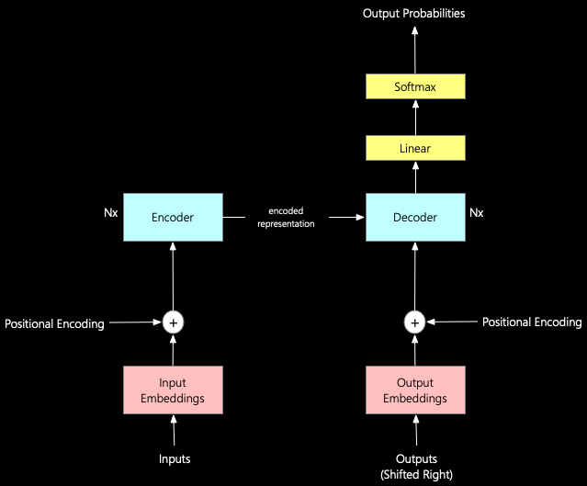
Notes:
We’ve all seen it typing…

Slide 40
Notes:
We’ve all seen it typing…

Slide 41
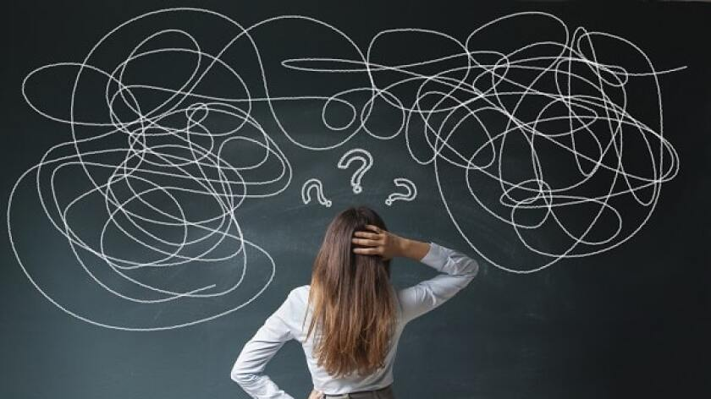
We have…
fake data
differences in opinions
limited perspective
stereotyping
social conformity
historical bias
confirmation bias
Notes:
Blurry Fake Fuzzy Confuzing on slides….
->

Slide 42
As a result we get
Biased content
Wrong Logic
Fake Data
Blurry, skewed, fuzzy, inaccurate, assumptions
Notes:
Blurry Fake Fuzzy Confuzing on slides….
->

Slide 43
We do not feed data. We feed stories
Notes:
Blurry Fake Fuzzy Confuzing on slides….
->
, and all stories told have tonality, character, personality, colour, history, religion..

Slide 44
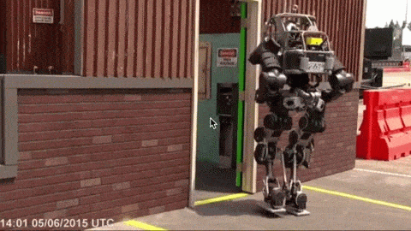
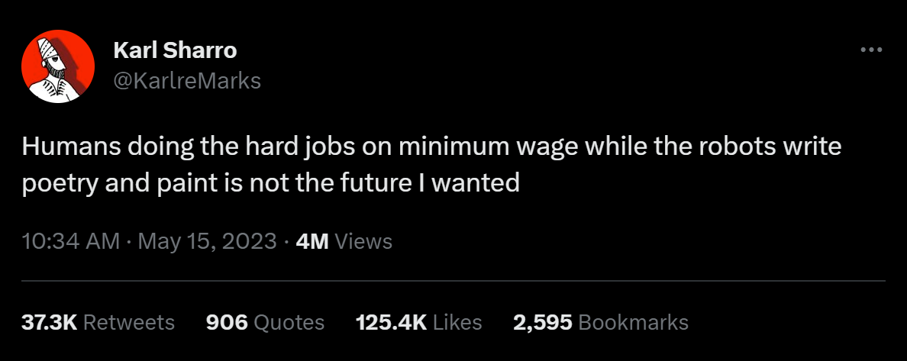
We have robots amplified with our own flaws and biases
Notes:
Output of all AI and LLM’s.. We generate content that’s at least partly wrong.
The next generation will be fed with this…
Downward-spiraled going to collapse.
But what can we do against? Trust Microsoft? Trust Meta? And that’s enough..?

Slide 45
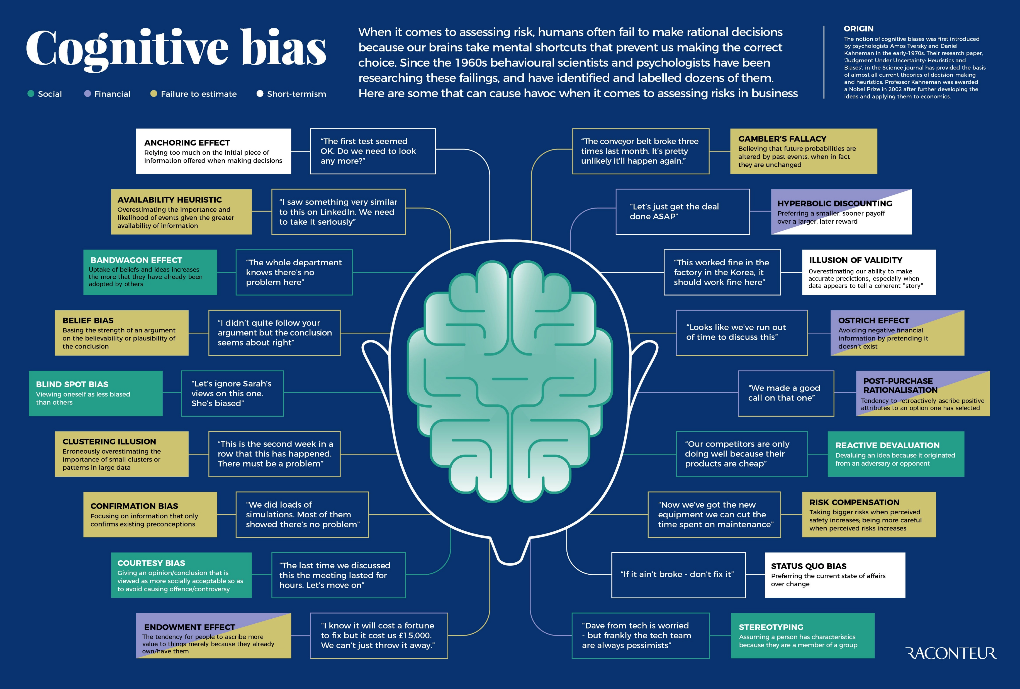
Notes:
Don’t discuss, only tell there are a lot..
Bias Bingo -> plenty of winners soon. Unavoidable to check multiple ones
Unconscious about them.
Status quo bias: if it aint broke, don’t fix it – aka never change a running system
Confirmation bias:focus on info that only suports existing preconceptions
Ostrich effect: avoiding begative financial info pretending it doesn’t exist.

Slide 46

DEPRESSION

Slide 47
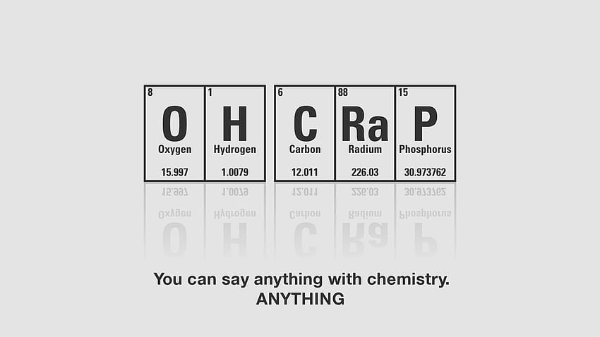
Notes:
Are we now doomed?
If a I am biased, why should I try to avoid it than?
Does it matter if everyone’s biased? Maybe it levels out?
Give up, let machines control us and pray to the overlord.

Slide 48

Notes:
Us, before we had coffee

Slide 49
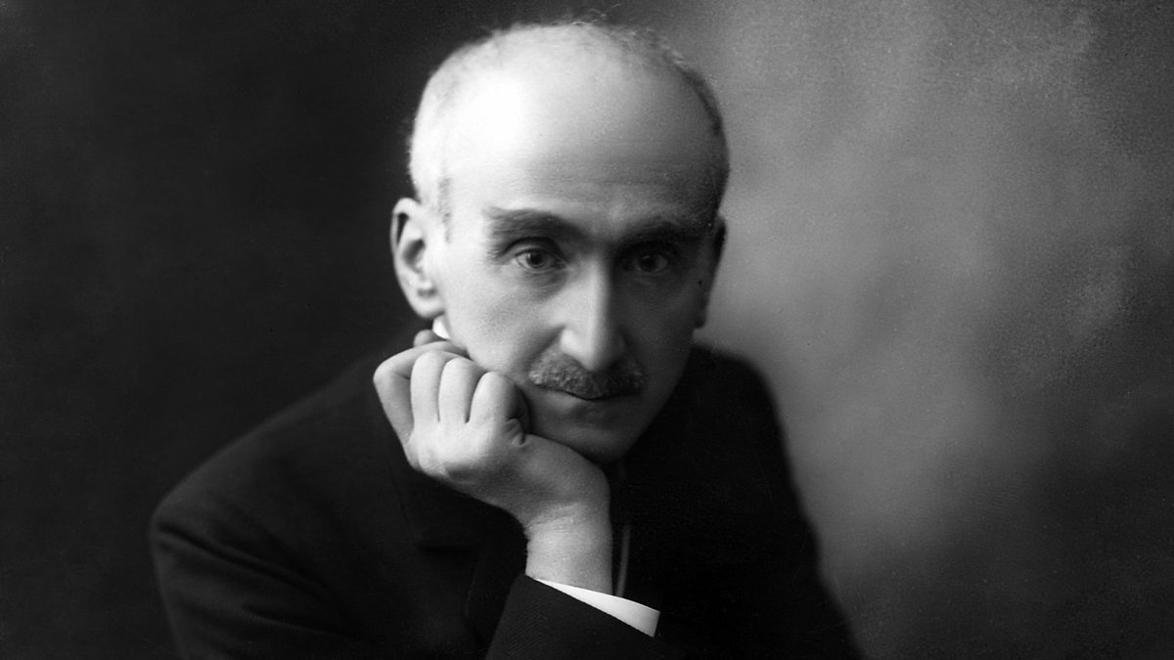
“The eyes will only see
what the mind is prepared to comprehend ”
- Henri-Louis Bergson
Notes:
Our mind is programmed to prefer or think in specific ways, even without knowing… We eat what we’re fed.
We can however, start think critically about ourselves.

Slide 50

Notes:
What is my Bias? What am I measuring it against?
When born? Where? Race? Gender?
Can I Justify my bias with: Belief, Blind spot, Clustering Illusion, confirmation bias, courtesy, empowerment,
Important to know not only your strengths, but also your weaknesses…
Step 1 to overcome your problem is to face it. Insights help.
You can blame it, you can name it, so you can work on it!

Slide 51
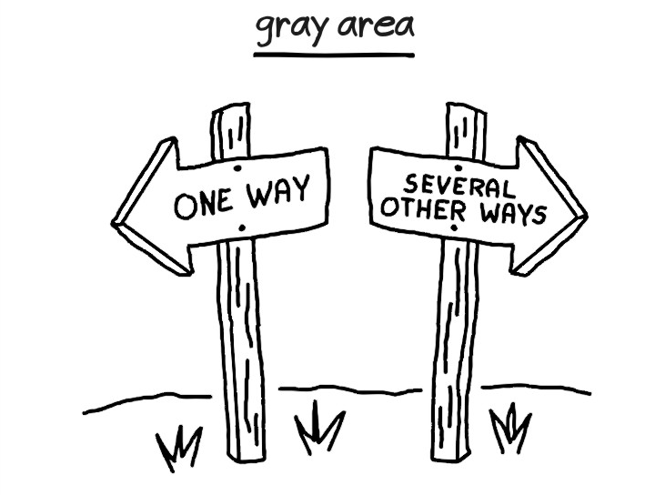
Notes:
- Nuance as to where the line of the bias resides.
- We are all biased, floating around a dotted thin line?

Slide 52
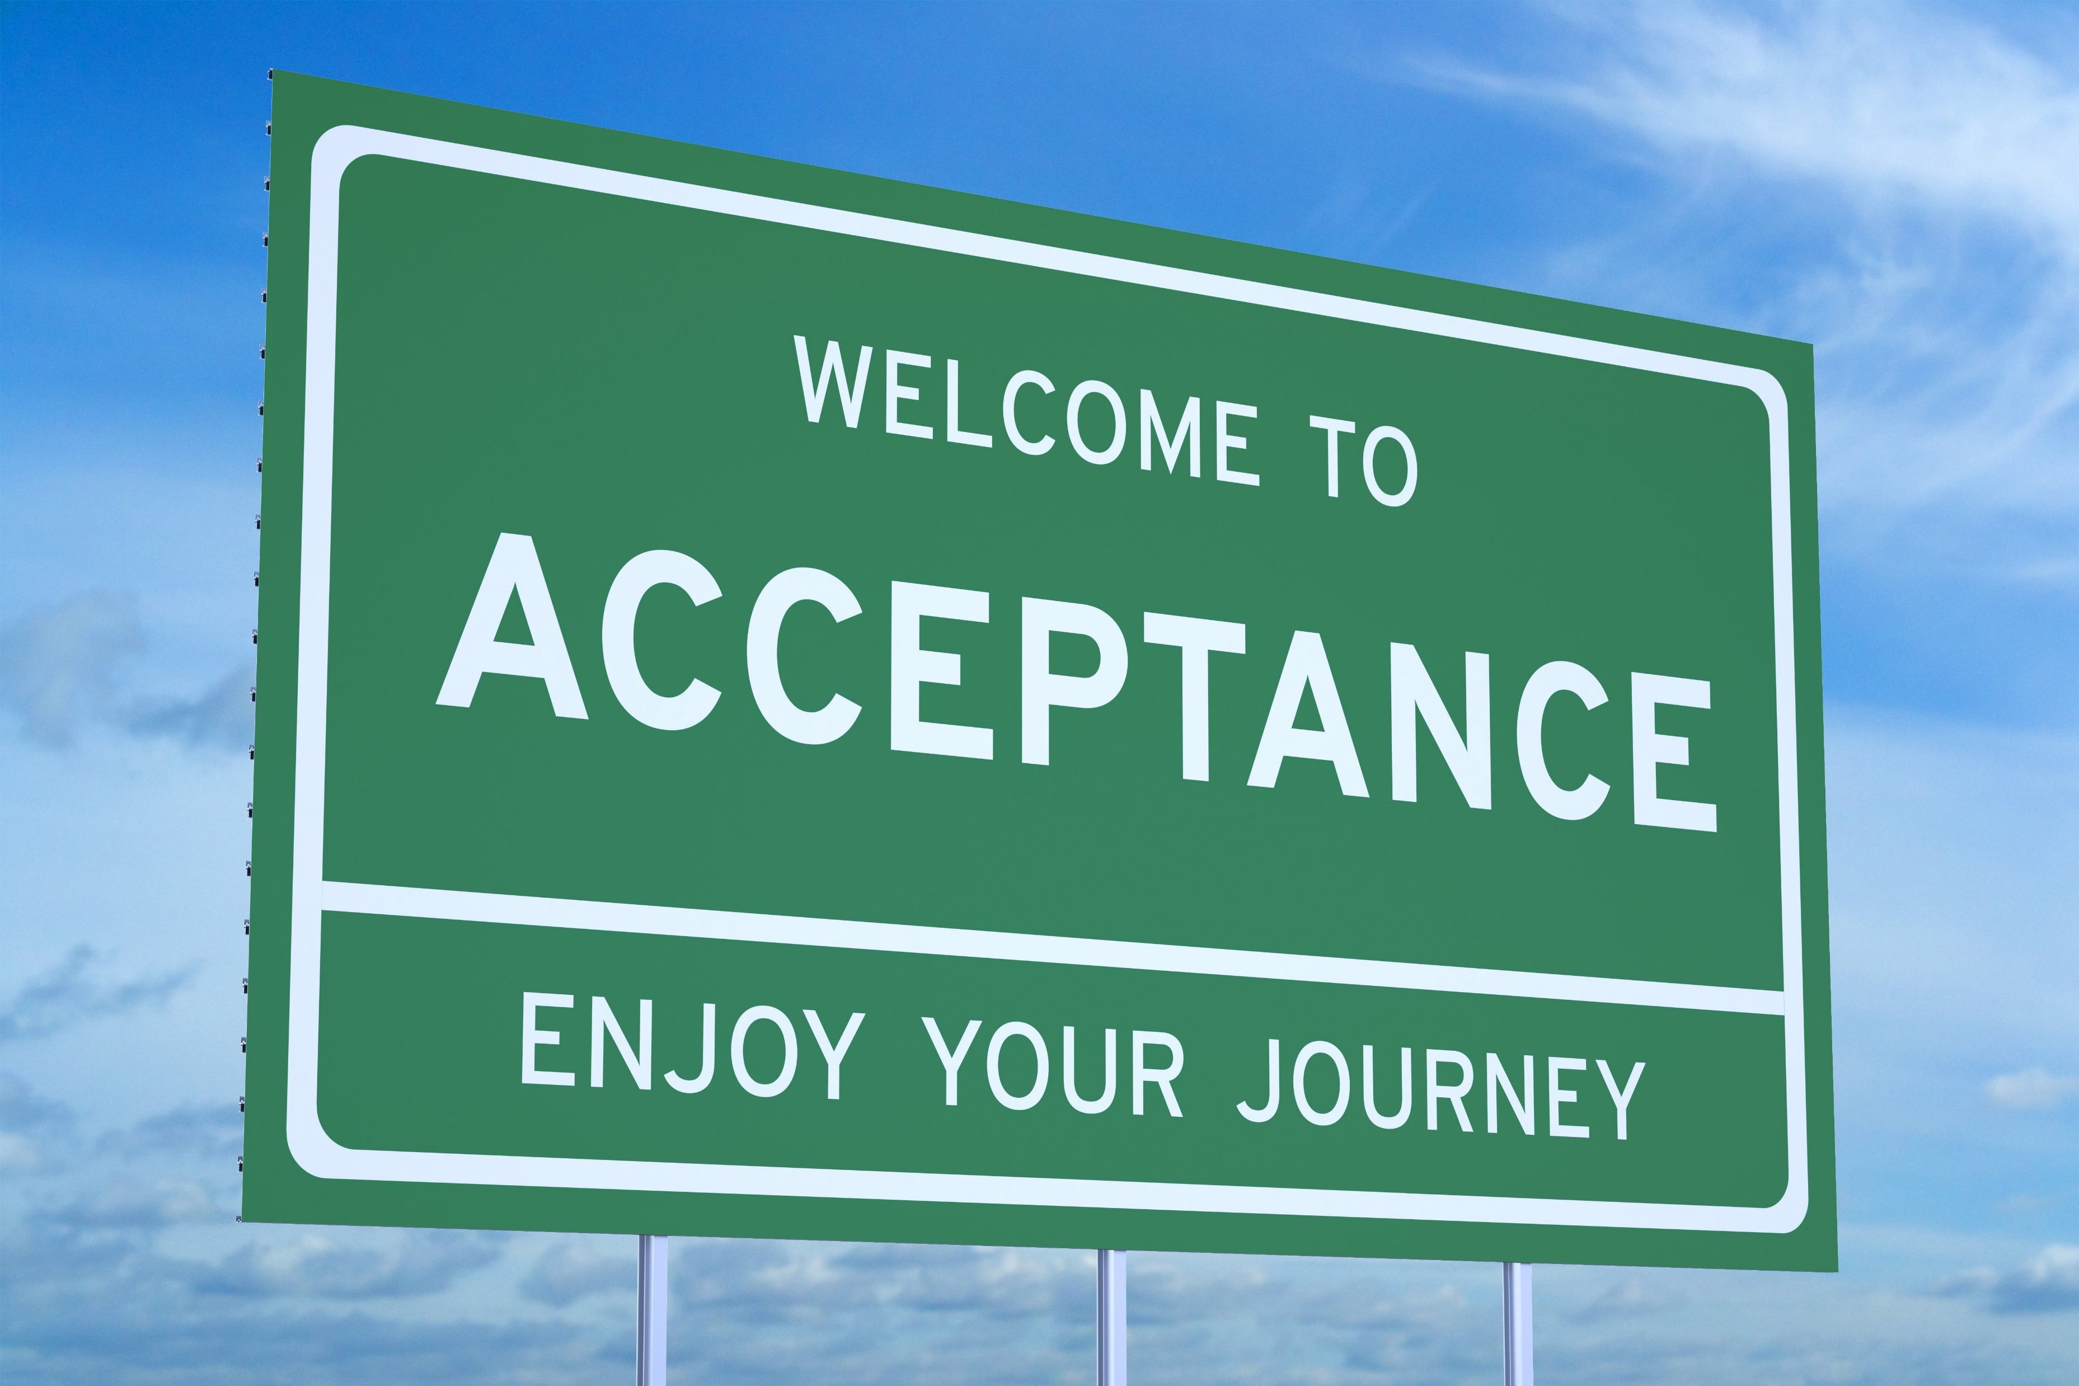
ACCEPTANCE
Notes:
Congratulations , you made it to part 5! We now invite you to fasten your seat belts, put up your tray and remain calm, as we will likely still experience some turbulences on the way.

Slide 53
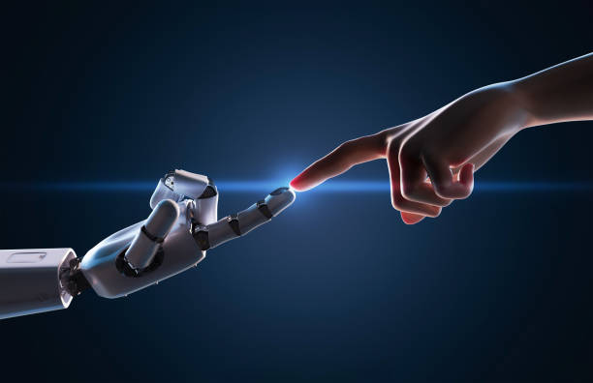
Notes:
AI can be helpful. A starter, not a replacement
- (In)famous quote of hemmingway: Write drunk, edit sober!
Ask a template and rewrite? There’s nothing wrong with that.
Only minor tweaks however, is that what you want to aim for? Who is going to actually do a fact-check?
The responsibility is still on our side.
We are not in writing mode, we are editing whatever something else is spitting out to us.
We are debugging code from others that we didn’t think up. Can we understand what the idea of the flow was?

Slide 54
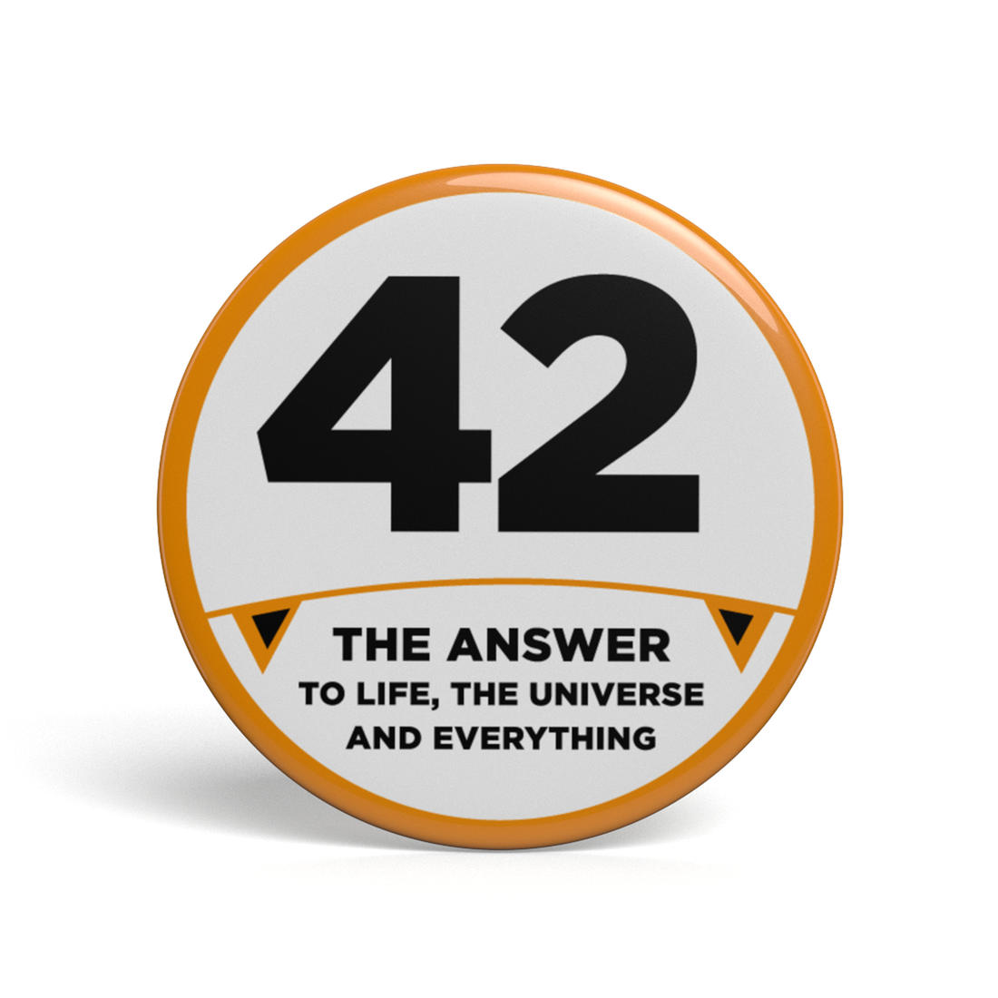
Notes:
A human supercomputer, AI in fiction ;-)
Artificial Intelligence is not intelligence, it’s simply named after the way neurons LOOK LIKE, not OPERATE LIKE.

Slide 55

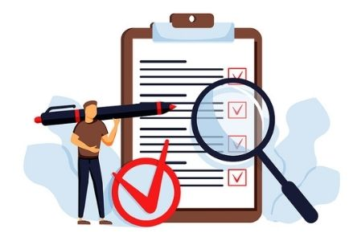
Notes:
Use real intelligence to validate and confirm.

Slide 56
Notes:
Use real intelligence to validate and confirm.
Without tools, no responsibility on validation, with AI, I get way more responsibility. I am becoming this manager verifying my employee’s ‘content’

Slide 57
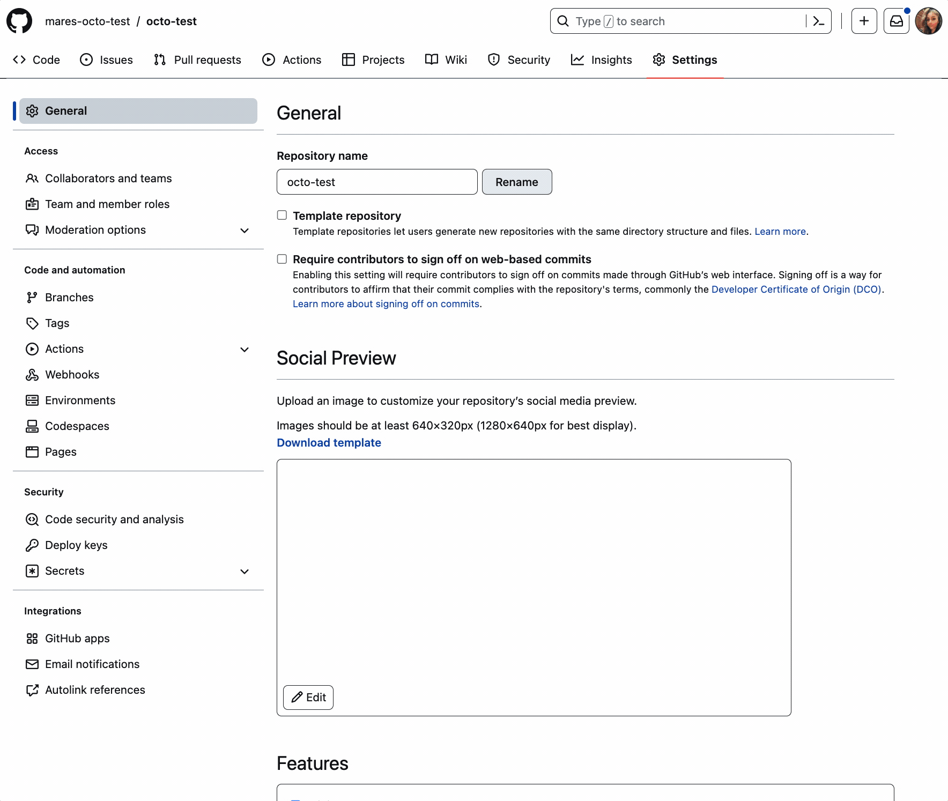
Notes:
We are shifting left with regards to security and responsibilities.

Slide 58
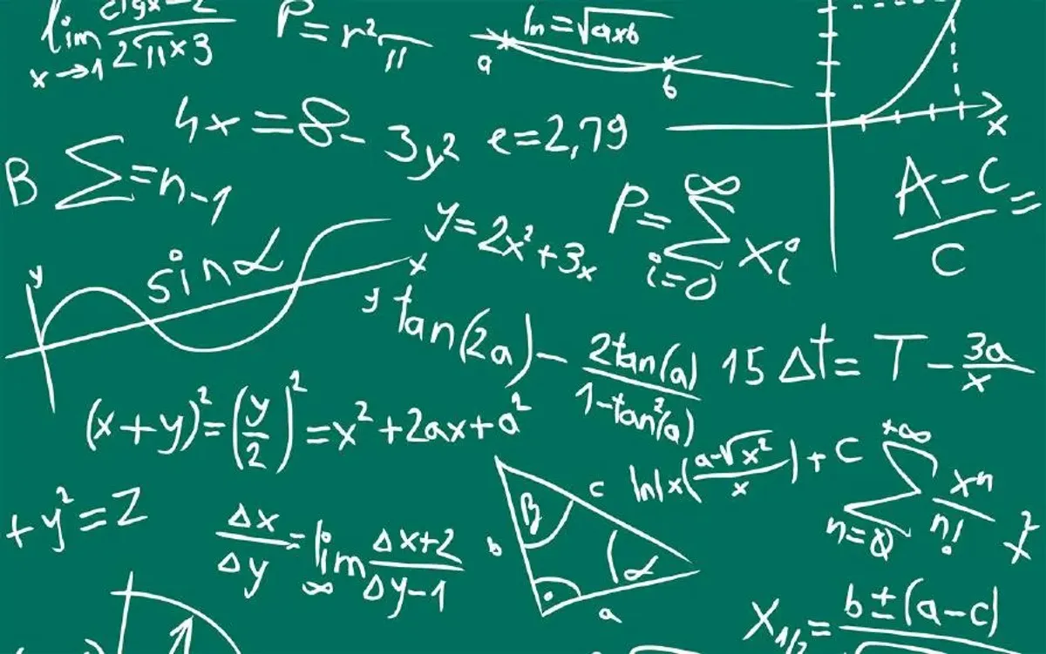
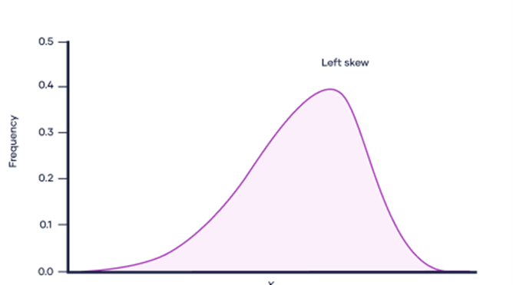



Slide 59


Nothing in life is
normally distributed right?

Slide 60

Notes:
And it shouldn’t be?

Slide 61

Rebalancing our data
Notes:
How can we be Going back to the middle line>?

Slide 62


Slide 63

Notes:
-The final chapter. Our takeaway

Slide 64

Notes:
We are all biased

Slide 65

Notes:
Your data is biased

Slide 66

Notes:
Your AI is reflecting YOU.

Slide 67

Notes:
Right now, we only started our journey towards the top of the mountain.
We have a path ahead full of pitfalls, biases and other complications. The only choice we have right now, do we steer away, or do we overcome?

Slide 68

Last slide

Slide 69


Kidding! This is the last one ☺
You want slides? You get slides!

